Slide 1
The Women’s Rights’ Movement in the 19th Century
Mr. Ayala Presents

Slide 2
Things to Ponder/ Objectives
1) You will be able to identify the people of the Women’s Movement and their contributions.
2) You will be able to explain how the Women’s Movement and Abolition movements are similar.

Slide 3
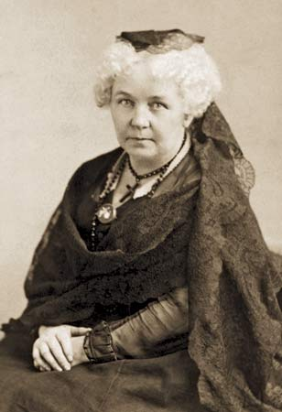
Abolition and Women’s Rights
I) Women Reformers Face Barriers
A) Elizabeth Cady Stanton, wanted to join the World Anti-Slavery Convention in London, was not allowed to speak
B) Women in 1800s enjoyed few legal or political rights.
C) Women started to decide that it was time to fight for women’s rights.

Slide 4
Abolition and Women’s Rights
II) Seneca Falls Convention
A) Stanton and Mott hold the Seneca Falls Convention in Seneca Falls, New York, July 19 -20, 1848. To fight for women’s rights.
B) There they wrote the Declaration of Sentiments and Resolutions
C) Many fought for suffrage
D) Some men and newspapers made fun of women who wanted to vote and have equality with men.

Slide 5
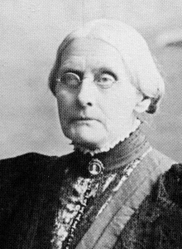
Abolition and Women’s Rights
III) Continued Calls for Women’s Rights
A) Sojourner Truth, wanted to attach abolishment of slavery with women’s rights.
B) Susan B. Anthony, a skilled organizer who worked both in temperance and women’s movements.
1) Helped states pass property laws for married women.

Slide 6
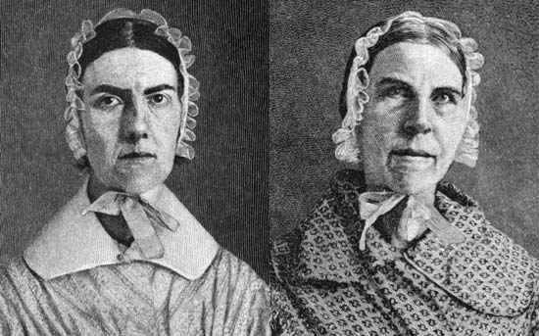
Women’s Rights Movement
IV) Grimke Sisters
A) Daughters of slave owner
B) Fought for abolition of slavery
C) Became Feminist Icons because of their lectures on slavery and the role of women in Reform movements

Slide 7
Women’s Rights
V) Women’s Rights Movement and Abolition
A) They both wanted to give rights to those who were denied rights in the United States.
B) Women would receive no rights that they Fought for until the 20th Century
C) African Americans would be freed with the 13th Amendment in 1865

Slide 8
Women’s Rights
VI) Temperance Movement
1) Influenced by the Women’s Movement and churches
2) 19th Century alcohol was everywhere and a major issue for individuals and families
3) Alcohol consumption will decline, but no real change occurred.

Slide 9
Picture Citations
Wiki-commons
Microsoft clip Art

