Slide 1
Bell work 34.15: Copy these vocabulary words. Title this: Regions of the US .
Climate: the average course or condition of the weather at a place usually over a period of years as exhibited by temperature, wind velocity, and precipitation
Precipitation: quantity of water falling in a specific area during a specific time.
Continental climate: large changes in weather throughout the year (seasons)
Subtropical climate: hot, humid summers with rain. Short, dry winters.
steppe climate: dry continental climate
alpine climate: colder climate above which trees may grow
Mediterranean climate: dry summers, mild, wet winters

Slide 2
Regions of the US
A Mr. Ayala mini lesson

Slide 3
Objectives
1) You will be able to describe the 5 major regions of the United States.

Slide 4
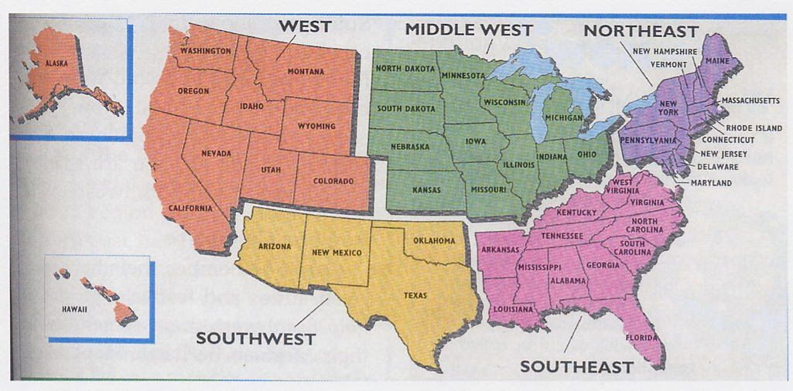
The 5 Major regions in the US
I) Five major regions
A) Northeast
B) Southeast
C) Middle West (mid-west)
D) West
E) Southwest

Slide 5
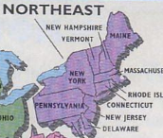
The 5 Major regions in the US
II) The Northeast
A) States:
1) Maine, Massachusetts, Rhode Island, Connecticut, New Hampshire, Vermont, New York, Pennsylvania, New Jersey, Delaware, Maryland
B) Climate
1) Humid continental climate with cool summers in the northern most areas. Moderate precipitation (rainfall).
C) Major Geographic features
1) Appalachian Mountains, Atlantic Ocean, Great Lakes, Canada to the North

Slide 6
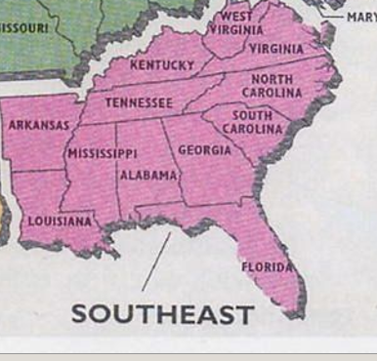
The 5 Major regions in the US
III) The Southeast
A) States: West Virginia, Virginia, Kentucky, Tennessee, North Carolina, South Carolina, Georgia, Alabama, Mississippi, Arkansas, Louisiana, Florida
B) Climate
1) humid subtropical climate, hot summers, hurricanes in the summer and fall along the Gulf and Atlantic Coasts, high precipitation
C) Major Geographic Features:
1) Appalachian Mountains, Atlantic Ocean, Gulf of Mexico, and Mississippi River

Slide 7
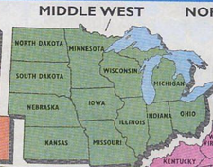
The 5 Major regions in the US
IV) Mid-west
A) States: Ohio, Indiana, Michigan, Illinois, Missouri, Wisconsin, Minnesota,
Iowa, Kansas, Nebraska, South Dakota, North Dakota
B) Climate:
1) Humid continental climate, snow is common, moderate precipitation, thunderstorms and tornadoes are common
C) Major Geographic features:
Great Lakes, Great Plains, Mississippi River, Canada to the north

Slide 8
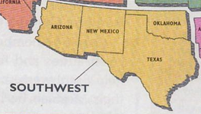
The 5 Major regions in the US
V) Southwest
A) States: Texas, Oklahoma, New Mexico, Arizona
B) Climate:
1) Semiarid (dry) steppe climate in the west and more humid in the east, desert or alpine in far west
C) Major Geographic Features:
1) Rocky Mountains, Colorado River, Gulf of Mexico, Mexico to the south

Slide 9
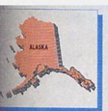
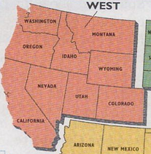
The 5 Major regions in the US
VI) West
A) States: Colorado, Wyoming, Montana, Idaho, Washington, Oregon, Utah, Nevada, California, Alaska, Hawaii
B) Climate
1) Range from semiarid and alpine along the mountains. Coastline is Mediterranean climate in California. Desert in Nevada and Southern California. Mixed precipitation levels.
C) Major Geographic features
1) Rocky Mountains, Sierra Nevada, Mohave desert, Pacific Ocean, Canada to the north, Mexico to the south.

Slide 10
Since we are done early:
Waco sings the 50 states: https://www.youtube.com/watch?v=bx6c_EefZAQ&ab_channel=WBKids
Tour of the States (Song): https://www.youtube.com/watch?v=_E2CNZIlVIg&ab_channel=MarblesTheBrainStore

